Slide 1
Explain the different type of transmission medias and its characteristics.
Prepare notes on MODEMS and its standards.
Write short note on X.21 digital interfaces.

Slide 2
DATA LINK LAYER - FUNCTIONS
Providing a well-defined service interface to the network layer.
Provides services for the reliable interchange of data across a data link established by the physical layer.
Link layer protocols manage the establishment, maintenance, and release of data-link connections.

Slide 3
Data-link protocols control the flow of data, dealing with transmission errors, and supervise data error recovery.
Regulating the flow of data so that slow receivers are not swamped by fast senders.
Recovery from abnormal conditions.

Slide 4
To accomplish these goals, the data link layer takes the packets it gets from the network layer and encapsulates them into frames for transmission.
Each frame contains a frame header, a payload field for holding the packet, and a frame trailer.

Slide 5
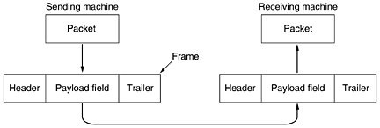
RELATIONSHIP BETWEEN PACKETS AND FRAMES

Slide 6
ERROR DETECTION AND CORRECTION
Error detection is applied mostly in the data-link layer but is also performed in other layers.
When a packet arrives at the destination, the destination may extract an error-checking code from the transport header and perform error detection.

Slide 7
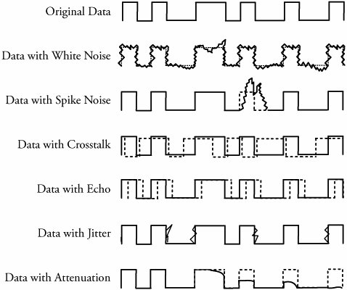
COMMON FORMS OF DATA ERRORS AT THE DATA-LINK LEVEL

Slide 8
TYPES OF ERRORS
The interference in transmission can change the shape of the signal; leads to an error in data transmission.
Basic types of errors are
    Single-Bit Error
    Burst Error

Slide 9
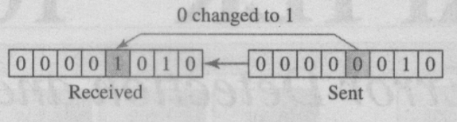
1. SINGLE-BIT ERROR
only one bit of a given data unit (such as a byte, character, data unit, or packet) is changed from 1 to 0 or from 0 to I.
In a single-bit error, only one bit in the data unit has changed.

Slide 10
SINGLE-BIT ERROR
A single-bit error can happen if we are sending data using parallel transmission.
For example, if eight wires are used to send all 8 bits of 1 byte at the same time and one of the wires is noisy, one bit can be corrupted in each byte.
Single-bit errors are less in serial data transmission.

Slide 11
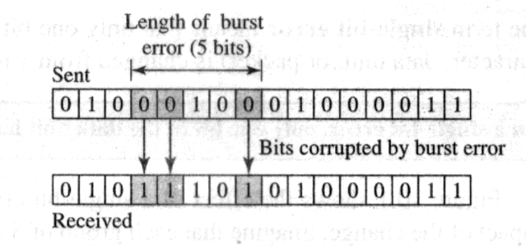
2. BURST ERROR
The term burst error means that 2 or more bits in the data unit have changed from 1 to 0 or from 0 to 1.

Slide 12
Burst error is most likely to occur in a serial transmission.
The duration of noise is normally longer than the duration of one bit, which means that when noise affects data, it affects a set of bits.
The number of bits affected depends on the data rate and duration of noise.

Slide 13
ERROR DETECTION
Most networking equipment at the data-link layer inserts some type of error-detection code.
When a frame arrives at the next hop in the transmission sequence, the receiving hop extracts the error-detection code and applies it to the frame.
When an error is detected, the message is normally discarded.

Slide 14
The most common approaches to error detection are based on Redundancy
send every data unit twice.
The receiving device would then able to do a bit for bit comparison between the two versions of the data.
Any discrepancy would indicate an error, and an appropriate correction mechanism could be set in place.

Slide 15
Error detection uses the concept of redundancy, which means adding extra bits for detecting errors at the destination.
This technique is called redundancy because the extra bits are redundant to the information; they are discarded as soon as the accuracy of the transmission has been determined.

Slide 16
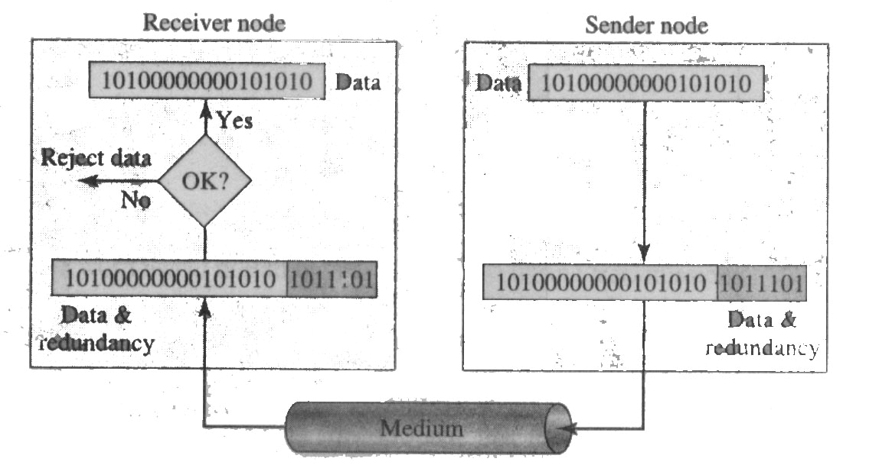

Slide 17
ERROR DETECTION
Three types of redundancy checks are common in data communications:
    Parity check,
    Cyclic Redundancy Check (CRC)
    Checksum

Slide 18
Error Detection
Parity Check
CRC
Checksum

Slide 19
1. PARITY CHECK
The most common and least expensive mechanism for error detection is the parity check.
Parity checking can be simple or two dimensional.

Slide 20
A. SIMPLE PARITY CHECK
In this technique, a redundant bit, called a parity bit, added to the unit so that the total number of 1’s in the unit (including the parity bit) becomes even (or odd).
Suppose we want to transmit the binary data unit 1100001

Slide 21
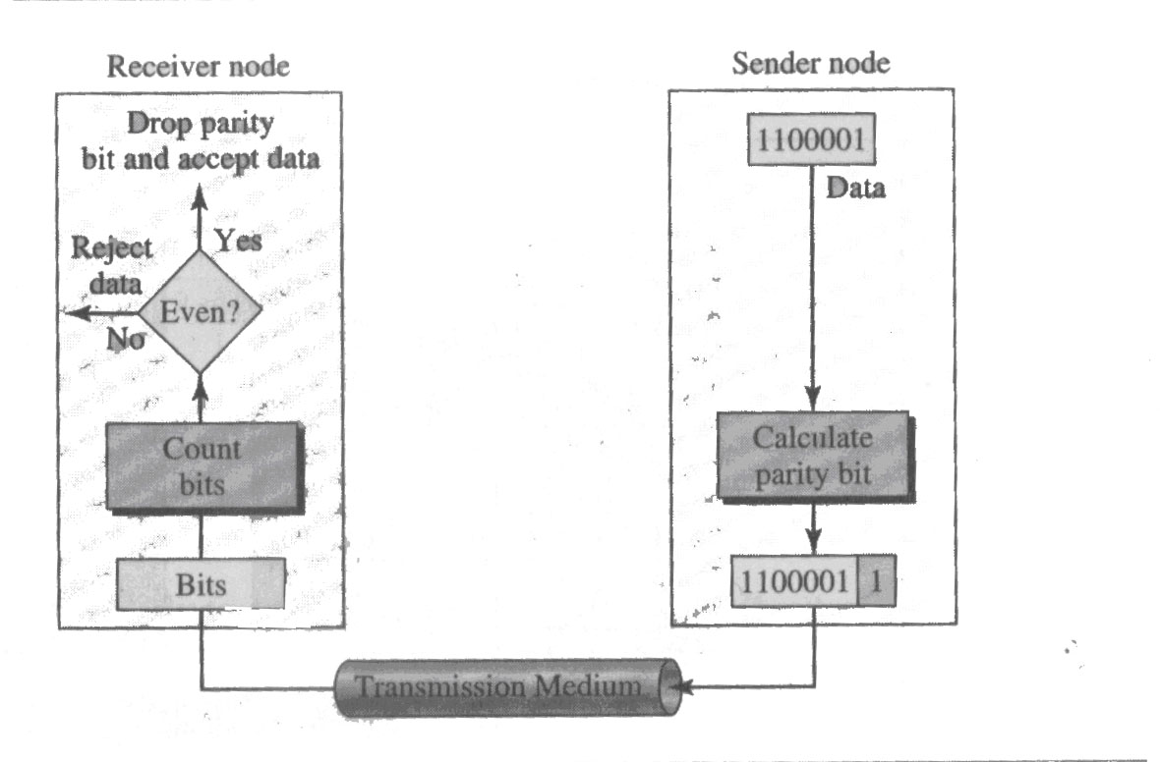
EVEN-PARITY CHECKING FUNCTION

Slide 22
SIMPLE PARITY CHECK - PERFORMANCE
Simple parity check can detect all single bit error.
It can also detect burst errors as long as the total number of bits change to odd (1, 3, 5, etc.).
Suppose, that 2 bits of the data unit are changed….????

Slide 23
TWO DIMENSIONAL PARITY CHECK
In this method, block of bits is organized as a table (rows and columns).
First we calculate the parity bit for each data unit.
Then we organize them into a table format.

Slide 24
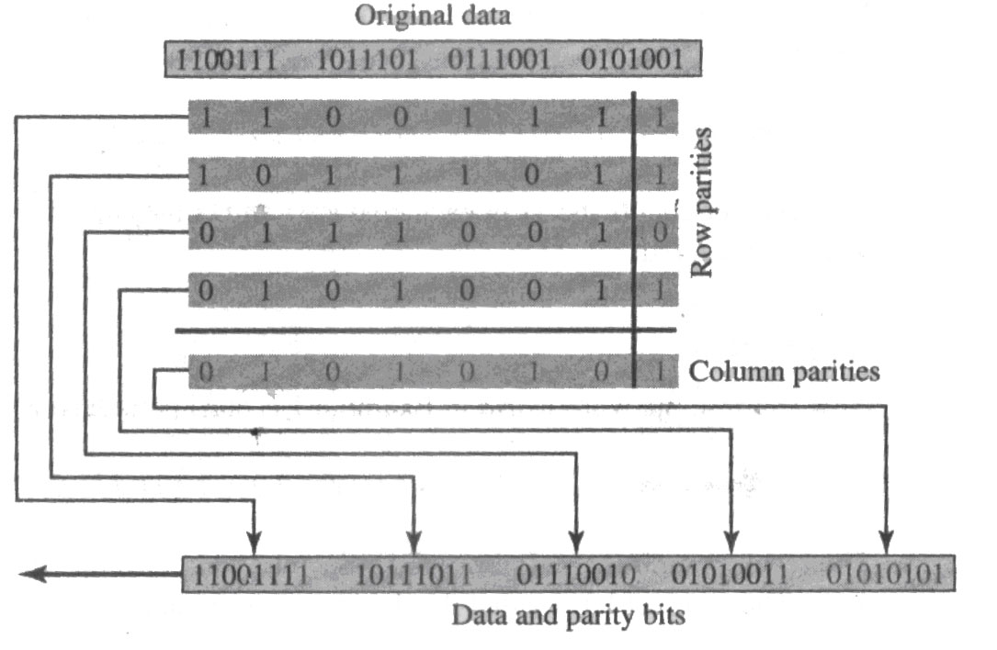
TWO DIMENSIONAL PARITY CHECK

Slide 25
PERFORMANCE
Two-dimensional parity check increases the chance of detecting burst errors.
A redundancy of n bits can easily detect a burst error of n bits.
If 2 bits in one data unit are damaged and two bits in exactly the same positions in another data unit are also damaged, the checker will not detect an error.

Slide 26
2. CYCLIC REDUNDANCY CHECK (CRC)
The most powerful of the redundancy checking techniques is the cyclic redundancy check (CRC).
Unlike the parity check which is based on addition, CRC is based on binary division.

Slide 27
CRC…
In CRC, a sequence of redundant bits, called the CRC or the CRC remainder, is appended to the end of a data unit so that the resulting data unit becomes exactly divisible by a second, predetermined binary number.

Slide 28
CRC…
At its destination, the incoming data unit is divided by the same number.
If at this step there is no remainder the data unit is assumed to be intact and is therefore accepted.
A remainder indicates that the data unit has been damaged in transmit therefore must be rejected.

Slide 29
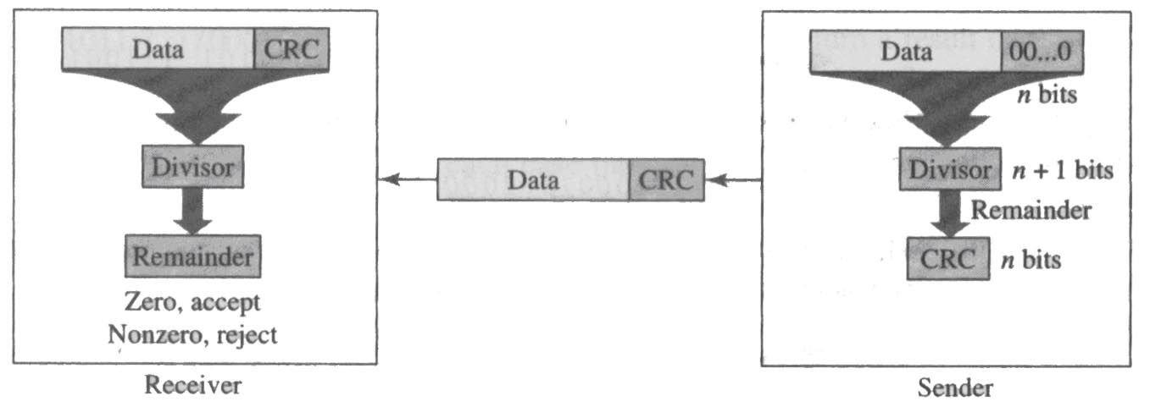
CRC…

Slide 30
THREE BASIC STEPS IN CRC.
A string of n 0s is appended to the data unit. The number n is 1 less than the number of bits in the predetermined divisor, which is n + 1 bit.
The newly elongated data unit is divided by the divisor, using a process called binary division. The remainder resulting from this division is the CRC.
The CRC of n bits derived in step 2 replaces the appended 0s at the end of the data unit. Note that the CRC may consist of all 0s.

Slide 31
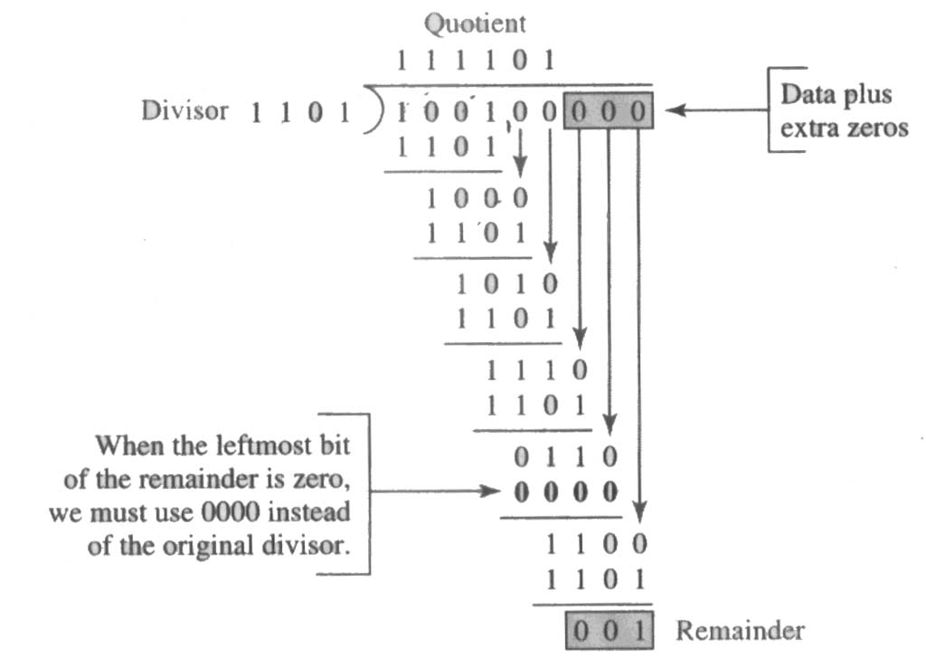
THE CRC GENERATOR

Slide 32
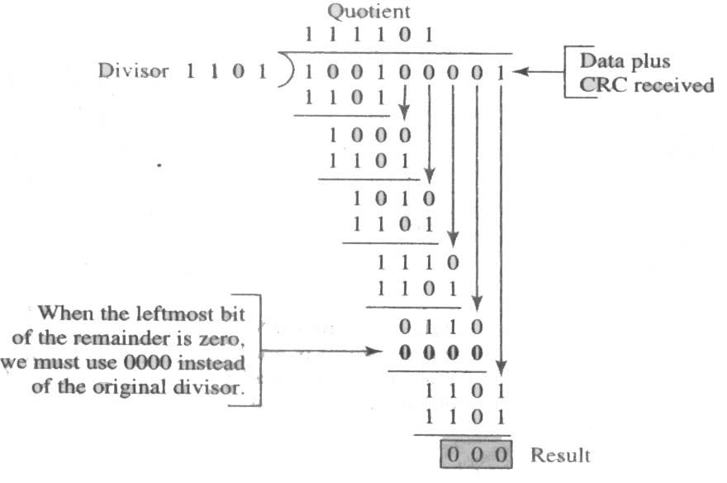
THE CRC CHECKER

Slide 33
POLYNOMIALS
The divisor in the CRC generator is most often represented not as a string of 1s and 0s, but as an algebraic polynomial, like x⁷+x⁵+x²+x+1
The polynomial format is useful for two reasons: It is short, and it can be used to prove the concept mathematically.

Slide 34
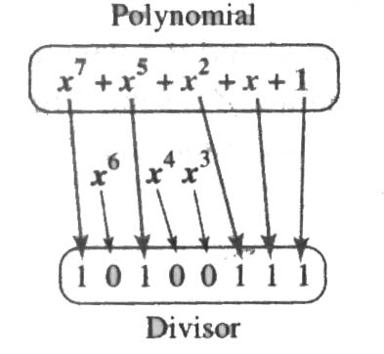
The relationship of a polynomial to its
corresponding binary representation

Slide 35
POLYNOMIAL - PROPERTIES
    It should not be divisible by x.
    It should be divisible by x + 1.
The first condition guarantees that all burst errors of a length equal to the degree of the polynomial are detected.
The second condition guarantees that all burst errors affecting an odd number of bits are detected.

Slide 36
PERFORMANCE
CRC can detect all burst errors that affect an odd number of bits.
CRC can detect all burst errors of length less than or equal to the degree of the polynomial.
CRC can detect, with a very high probability, burst errors of length greater than the degree of the polynomial.

Slide 37
3. CHECKSUM
Like the parity checks and CRC, the checksum is based on the concept of redundancy.

Slide 38
CHECKSUM GENERATOR - SENDER
The unit is subdivided into k sections, each of n bits.
All these k sections are added using ones complement arithmetic in such a way that the total is also n bits long.
The sum is complemented and appended to the end of the original data unit as redundancy bits, called the checksum field
The extended data unit is transmitted across the network. So, if the sum of the data segment is T, the checksum will be -T.

Slide 39
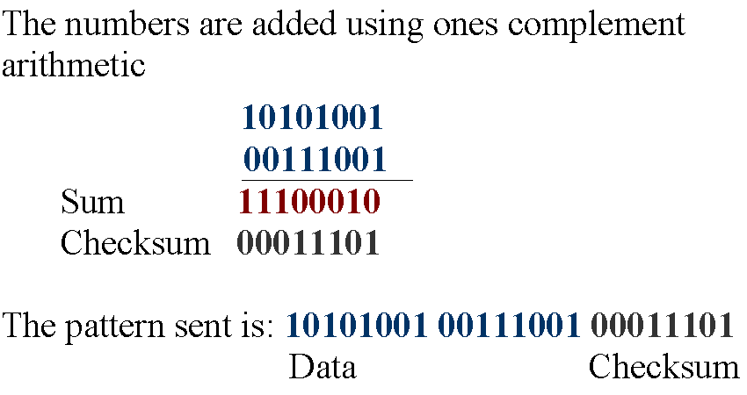
EXAMPLE: 10101001 00111001

Slide 40
CHECKSUM CHECKER– RECEIVER SIDE
The unit is divided into k sections, each of n bits as the checksum generation.
All sections are added using ones complement to get the sum.
The sum is complemented.
If the result is zero, the data are accepted: otherwise, they are rejected.

